Slide 1
PNEUMONIA AND COVID DETECTION FROM
CHEST-XRAYS USING AI

Slide 2
GUIDED BY:
ARPITHA GUPTHA
TEAM MEMBERS
KAMANI NANDINI - 2010030385
DEEPTHI SRI – 2010030450
VIDYASRI – 2010030534
VAISHNAVI – 2010030537

Slide 3
TABLE OF CONTENTS:
INTRODUCTION
PROBLEM STATEMENT
MOTIVATION
OBJECTIVES
LITERATURE SURVEY
DATASET
TECHNIQUES
CONCLUSION
REFERENCES

Slide 4
INTRODUCTION
The past one and half years were very tough and stressful for the entire globe with the outbreak of one of the most contagious corona virus diseases (COVID-19) attacking humanity and causing severe pneumonia-type symptoms targeting human respiratory systems. Also other disease, Pneumonia is an acute pulmonary infection that can be caused by bacteria, viruses, or fungi and infects the lungs, causing inflammation of the air sacs and pleural effusion, a condition in which the lung is filled with fluid. Pneumonia is most common in underdeveloped and developing countries, where overpopulation, pollution, and unhygienic environmental conditions exacerbate the situation, and medical resources are scanty.
Therefore, early diagnosis and management can play a pivotal role in preventing the disease from becoming fatal. A large percentage of the COVID-19 infected people showed mild or no symptoms, others experienced and developed severe respiratory symptoms, even leading to death. Machine Learning (ML) and Deep Learning (DL), being subfields of AI, were considered in automating the process of COVID-19 detection through the classification of the chest X-ray/CT scan images. A survey of the literature shows that DL-based models tackling this type of classification problem outnumbered ML-based models. High classification performance in terms of accuracy, recall, precision, and F1-measure was reported in most of these studies.
However, most of these classification models were trained and tested on relatively smaller datasets featuring either two (COVID-19 infected vs. normal) or three classes (COVID-19 infected, pneumonia case, normal). This dataset size constraint makes the proposed models just a proof-of-concept of COVID-19 patient detection, and therefore these models require re-evaluation with larger datasets.

Slide 5
PROBLEM STATEMENT
Our goal is to build a covid pneumonia detection system to locate the position of inflammation in image. Even for trained Radiologists, it sometimes or in some cases might be a challenging task to examine chest x – ray images. There is a need to improve diagnosis accuracy. So the aim of our project is to design an intelligence system that receives x – ray images of the lungs as an input parameter and based on the processed image, detects the possibility of pneumonia as well as covid as an output. We want to build an algorithm to automatically identify whether a patient is suffering with covid pneumonia or not by looking into the chest x – ray images. We want to make this algorithm extremely accurate because lives of people is at stake. For this project, an efficient model for detection of covid pneumonia trained on digital chest x – rays is proposed, which acts as an aid for radiologists in their decision making process. X – ray images which are used for diagnosis of pneumonia and covid need expert radiotherapists for evaluation. Thus developing an automatic system for detection would be beneficial for treating the diseases without any delay particularly in remote areas.

Slide 6
MOTIVATION
Pneumonia impacts the elderly and young people's families and children everywhere but is most prevalent in Sub-Saharan Africa and South Asia. In December 2019 Wuhan, a city of China was affected by deadly, gruesome Pneumonia which was declared as a pandemic by World Health Organization. But the reason for the outbreak was not clear to everyone. Later, the doctors identified the disease as a new species of coronavirus, also currently known as COVID-19.The main motivation behind this research was to identify Pneumonia and covid just by using the X-Ray images of the patients. As doctors must do a lot of certain tests to identify if the patient has Pneumonia/Covid or not.

Slide 7
OBJECTIVES
One of the critical factors behind the rapid spread of COVID-19 pandemic is a lengthy clinical testing time. The imaging tool, such as Chest X-ray (CXR), can speed up the identification process. Therefore, our objective is to develop an automated CAD system for the detection of COVID-19 samples from healthy and pneumonia cases using CXR images.

Slide 8
LITERATURE REVIEW
s.no | Title | Year | Authors | Pros | Cons
1. | Artificial intelligence on COVID-19 pneumonia detection using chest x-ray images Link:https://doi.org/10.1371/journal.pone.0257884 | 2021 | Lei Rigi Baltazar, Manzanillo, Ethel, Mario Domingo, Beatrice Tiangco, Jason Albia. | Combine both low-level features and general shape of lung | Require proper initialization for a successful converge
2. | Viral and Bacterial Pneumonia Detection using Artificial Intelligence in the Era of COVID Link : https://orcid.org/0000-0003-3850-9921 | 2020 | SA Harmon, TH Sanford, S Xu, EB Turk. | High information suitable for big data applications. | Long training process Needs large set of annotated data
3. | COVID-19 on Chest Radiographs: A Multi reader Evaluation of an Artificial Intelligence System Link:https://doi.org/10.1148/radiol.2020201874 | 2020 | Tijs Samson, Ernst T .Scholten, Steven, Henk Smits, Michael. | Similar accuracy as in inter-observer performance | Higher Computational complexity
4. | Diagnosis of Coronavirus Disease 2019 Pneumonia by Using Chest Radiography: Value of Artificial Intelligence Link:https://doi.org/10.1148/radiol.2020202944 | 2019 | Zhang, Ran, Xin Tie, Zhang, Dalton Griner, Thomas K. Song | Values of layer thickness and the length of the period of a multiplayer can be selected. | X-rays from the multilayer may cause a problem

Slide 9
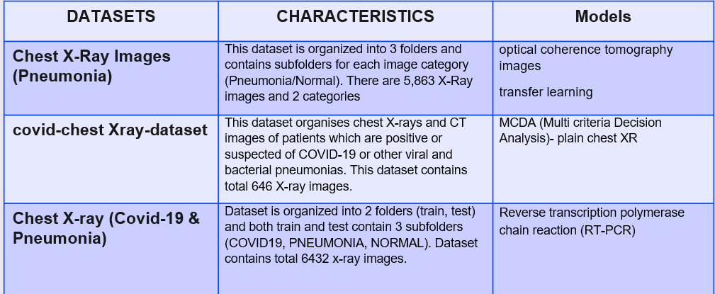
DATASETS

Slide 10
MODELS AND TECHNIQUES
Convolutional Neural Network:
CNN is a type of neural network model which allows us to extract higher representations for the image content. Unlike the classical image recognition where you define the image features yourself, CNN takes the image’s raw pixel data, trains the model, then extracts the features automatically for better classification.
ResNet :
ResNet is a powerful backbone model that is used very frequently in many computer vision tasks. ResNet uses skip connection to add the output from an earlier layer to a later layer.
Transfer Learning:
This method focuses on storing knowledge gained while solving one problem and applies it to a different but related problem. For example, knowledge gained while learning to recognize pneumonia could apply when trying to recognize covid

Slide 11
DenseNet
DenseNet is one of the new discoveries in neural networks for
visual object recognition. DenseNet is actually quite similar to with some fundamental differences. As Previously mentioned ResNet uses
an additive method (+) that merges the previous layer (identity) with
the future layer, whereas DenseNet concatenates. This method utilizes
dense connections between layers, through Dense Blocks, where we
connect all layers directly with each other.
Multi criteria Decision Analysis:
A Multi-Criteria Analysis (MCA) can be used to identify and compare different policy options by assessing their effects, performance, impacts, and trade-offs. MCA provides a systematic approach for supporting complex decisions according to pre-determined criteria and objectives.

Slide 12
CONCLUSION
Early detection of pneumonia is crucial for determining the appropriate treatment of the disease and preventing it from threatening the patient’s life. Chest radiographs are the most widely used tool for diagnosing pneumonia; however, they are subject to inter-class variability and the diagnosis depends on the clinicians’ expertise in detecting early pneumonia traces. To assist medical practitioners, an automated CAD system was developed in this study, which uses deep transfer learning-based classification to classify chest X-ray images into two classes “Pneumonia” and “Normal.”
It describes the use of deep learning in order to classify digital images of chest X-rays according to presence or absence of changes consistent with pneumonia.
The implementation was using Python programming and scientific tools.

Slide 13
1.Baltazar, Lei Rigi, Gabriel Manzanillo, Ethel Dominique, Mario Domingo, Beatrice Tiangco, and Jason Albia. "Artificial intelligence on COVID-19 pneumonia detection using chest x-ray images." Plus one 16, no. 10 (2021): e0257884 2.Harmon, Stephanie A., Thomas H. Sanford, Sheng Xu, Holger Roth, Dong Yang et al. "Artificial intelligence for the detection of COVID-19 pneumonia on chest CT using multinational datasets." Nature communications 11, no. 1 (2020): 1-7. 3.Henk Smits, Michael BJM, Tijs Samson, Ernst T. Scholten, Steven. "COVID-19 on chest radiographs: a multi reader evaluation of an artificial intelligence system." Radiology 296, no. 3 (2020): E166-E172. 4.Zhang, Ran, Xin Tie, Zhang, Dalton Griner, Thomas K. Song et al. "Diagnosis of coronavirus disease 2019 pneumonia by using chest radiography: Value of artificial intelligence." Radiology 298, no. 2 (2021): E88-E97.
REFERENCE LINKS

Slide 14

